Slide 1

ECE 281 Lesson 13
Maj Jeffrey Falkinburg USAFA/DFEC
Room 2E46E 333-9193
1

Slide 2
Lesson 13 Outline
Do Time Logs!
VHDL Introduction
Component Declaration and Instantiation
Self Checking Testbenches
Examples/Practice

Slide 3
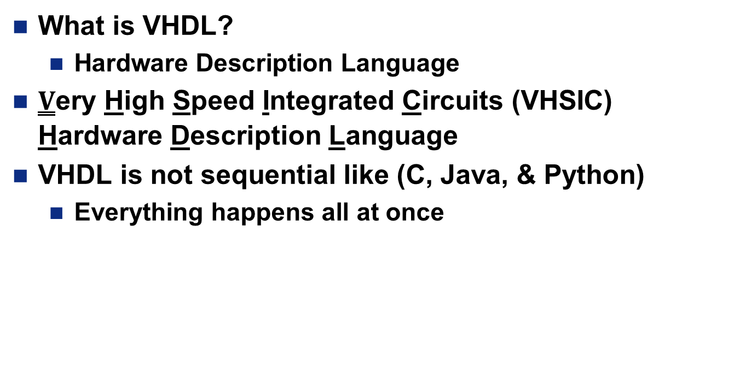
VHDL
What is VHDL?
Hardware Description Language
$\underline{V}$ery High Speed Integrated Circuits (VHSIC) Hardware Description Language
VHDL is not sequential like (C, Java, & Python)
Everything happens all at once

Slide 4
Xilinx – VHDL to Board
Transforms text description into Logic Gates
HDL
Synthesis
Translate
.ngd
Map, Place, & Route
Implement, Generate Programming File
.vhd
.ngc
Netlist - How things are connected
.ucf
.bit
Target Device

Slide 5
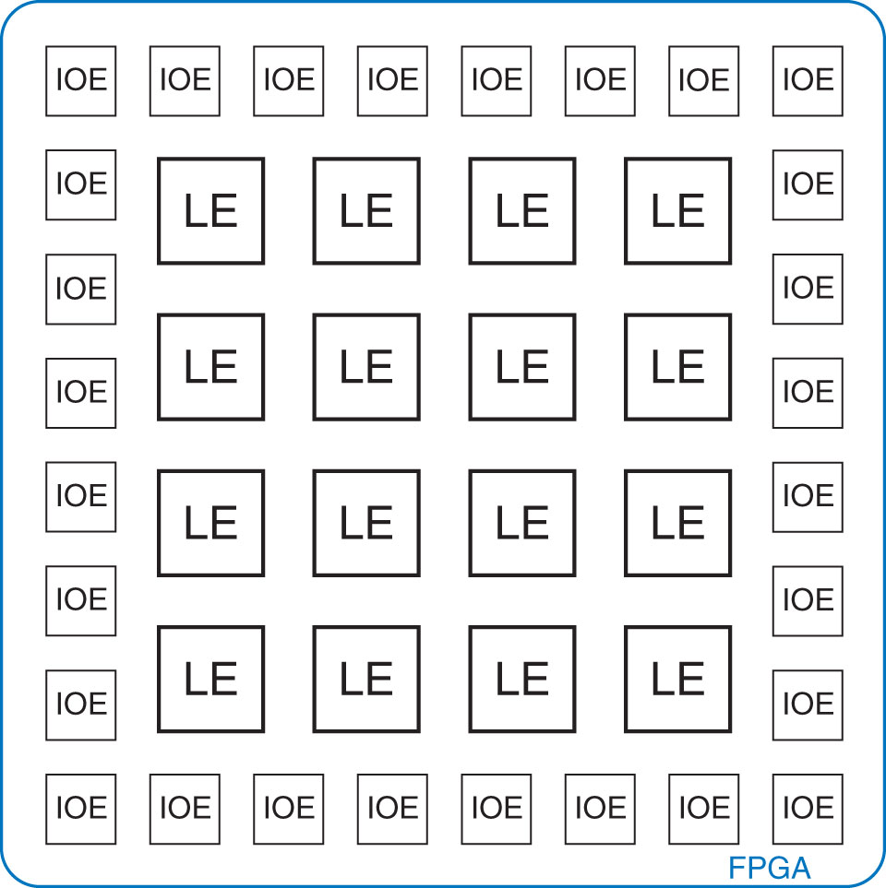
FPGA
Field Programmable Gate Array (FPGA)
Look-up table
Programmable interconnections
Made of LEs (Logic Elements) aka
CLB (Configurable Logic Blocks)
Figure 5.57 General FPGA layout
Copyright © 2013 Elsevier Inc. All rights reserved.

Slide 6
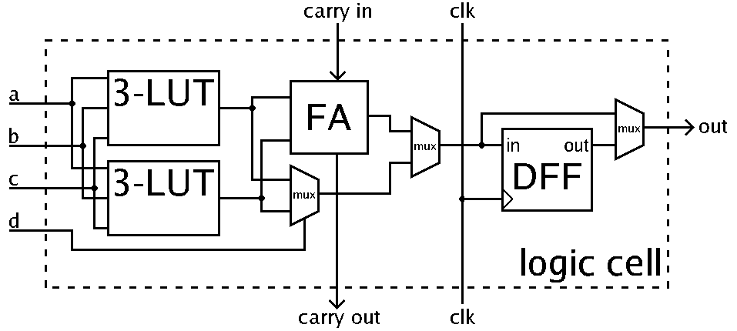
FPGA
Key parts of Logic Elements
Look-up table
Flip-flop (1-bit register)
Programmable interconnections via Multiplexers
By Petter.kallstrom - Public Domain, https://commons.wikimedia.org/w/index.php?curid=10224058

Slide 7
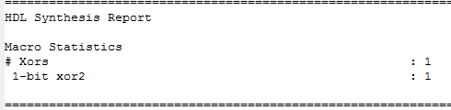
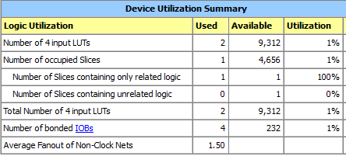
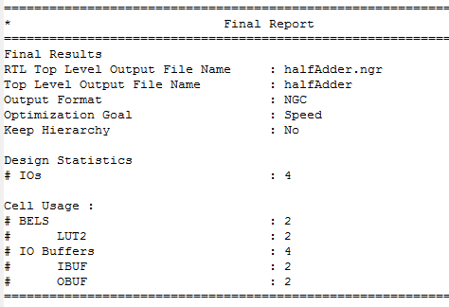
ISE Reports – CE2 Example

Slide 8
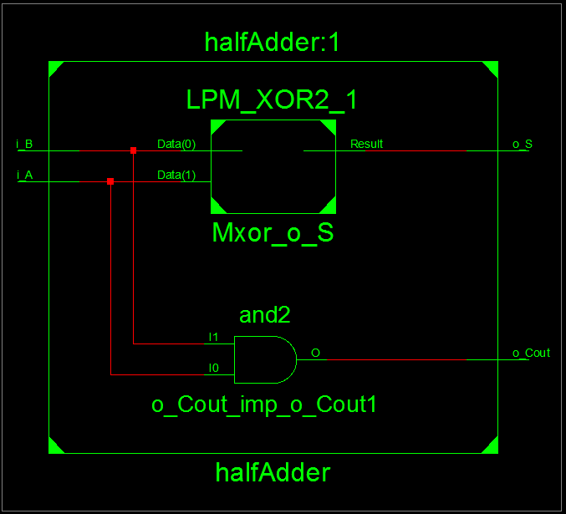
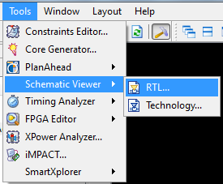
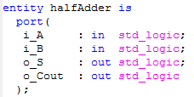

Viewing Schematics – CE2

Slide 9
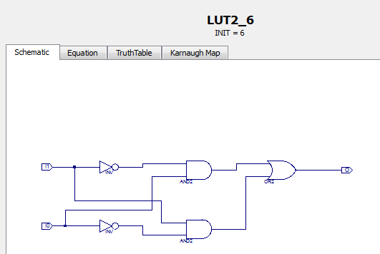
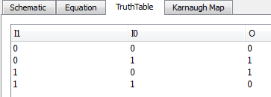
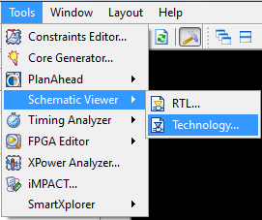
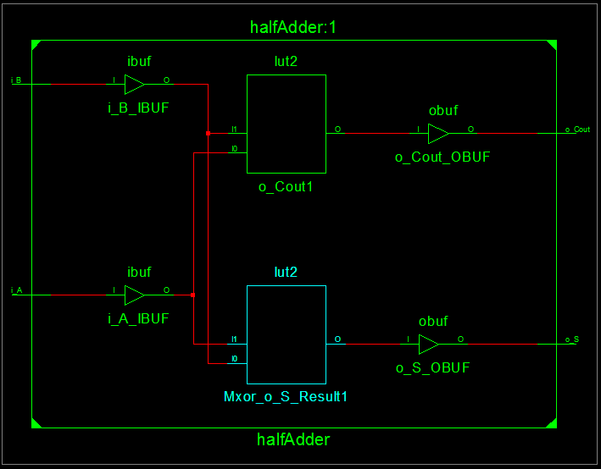
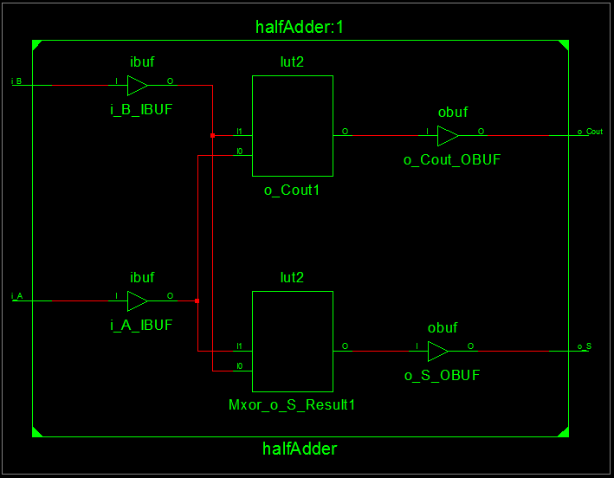
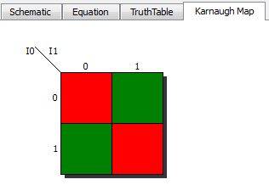
Viewing Schematics – CE2

Slide 10
Standard Logic Values
U – Uninitialized
X – Forcing Unknown
0 – Forcing ‘0’
1 – Forcing ‘1’
Z – High Impedance
W – Weak Unknown
L – Weak ‘0’
H – Weak ‘1’
- – Don’t Care
U | X | 0 | 1 | Z | W | L | H | -
Something probably wrong
Most common
Not commonly used

Slide 11
VHDL
Std_logic_vector – collection of signals in a bus
Entity – Defines inputs and outputs of box
Architecture – Describes what is inside the box
Signal declaration
Each concurrent statement can be thought of as a circuit part
Contains timing information
Arch body can be thought as a “collection of parts”
Modelling:
Behavioral – Describes what module does in terms of the relationships between inputs and outputs
Structural – Describes what a module does in terms of how it is composed of simpler modules

Slide 12
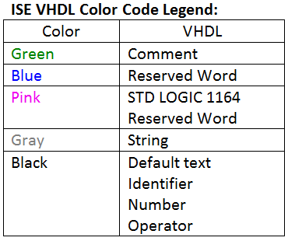
VHDL
library IEEE; -- These lines are similar to a #include in C
use IEEE.std_logic_1164.all;
entity ent_name is
Port ( port_name : mode signal_type;
… : … …);
end ent_name;
architecture arch_name of ent_name is
-- signal declarations (behavioral, structural)
-- component declarations (structural)
begin
-- connect your stuff here
end arch_name;

Slide 13
Component Declaration and Instantiation
How Many of you have investigated your testbenches?
Declaration: In Architecture…Before Begin (Make Known)
component Component_Name
port ( -- signal_name : mode signal_type;
Input0, Input1 : in std_logic;
Output :out std_logic);
end component;
Instantiation: In Architecture…After Begin (Component Used)
Component_Label: Component_Name
port map ( -- Port_name => Signal name,
Input0 => a,
Input1 => b,
Output => Y);

Slide 14
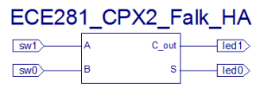
VHDL – Structural Definition
library IEEE; -- These lines are similar to a #include in C
use IEEE.std_logic_1164.all;
library unisim; -- Use these libraries if you are using primitive components
use unisim.vcomponents.all;
entity ce2_ha_structural is
Port ( A : in STD_LOGIC;
B : in STD_LOGIC;
S : out STD_LOGIC;
Cout : out STD_LOGIC);
end ce2_ha_structural;
Entity

Slide 15
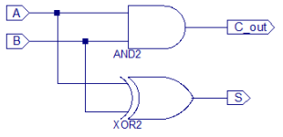
VHDL – Structural Definition
Entity
architecture Structural of ce2_ha_structural is
component AND2
port ( i0, i1 : in std_logic;
o :out std_logic);
end component;
component XOR2
port ( i0, i1 : in std_logic;
o :out std_logic);
end component;
signal s1, s2 : std_logic; -- wires which begin & end in the component
begin
Architecture

Slide 16
VHDL – Structural Definition
begin
unit1: AND2
port map ( -- s1 <= A AND B; (i.e. Cout)
i0 => a,
i1 => b,
o => s1);
unit2: XOR2
port map ( -- s2 <= A XOR B; (i.e. Sum)
i0 => a,
i1 => b,
o => s2);
Cout <= s1;
S <= s2;
end Structural;
Can be omitted for brevity, but it makes code harder to read…and debug!
Entity
Architecture
S1
S2

Slide 17
VHDL – Behavioral Definition
library IEEE;
use IEEE.STD_LOGIC_1164.ALL;
entity ce2_half_adder is
Port ( A : in STD_LOGIC;
B : in STD_LOGIC;
S : out STD_LOGIC;
Cout : out STD_LOGIC);
end ce2_half_adder;
architecture Behavioral of ce2_half_adder is
begin
S <= A xor B;
Cout <= A and B;
end Behavioral;

Slide 18
Wakerly Handout
Structural Implementation Example from Wakerly Handout:
https://sharepoint.usafa.edu/academics/eleccompengineering/ece281/Handouts/DDPP%204th%20Wakerly-5-3%20VHDL%20section.pdf
Table 5-30 Structural VHDL program for a prime-number detector.

Slide 19
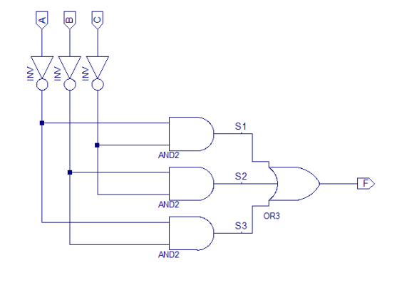
Minority Circuit
Minority Circuit – Output is high if a minority of the inputs are high
Entity
Minority
Truth Table
A | B | C | F
0 | 0 | 0 | 1
0 | 0 | 1 | 1
0 | 1 | 0 | 1
0 | 1 | 1 | 0
1 | 0 | 0 | 1
1 | 0 | 1 | 0
1 | 1 | 0 | 0
1 | 1 | 1 | 0
Architecture

Slide 20
Testbenches (Pgs 220 – 224)
Assert (check output)
Report (report message)
Severity (Error, Warning, Note, Failure)
A <= '0'; B <= '0'; C <= '0'; D <= '0' ; S <= "00";
wait for 10 ns;
ASSERT Y = '1' REPORT "Test 0000 00 Failed" SEVERITY ERROR;
-- Can use Error, Warning, Note, Failure
Be Careful with its use: What could be an issue?
Propagation Delay

Slide 21
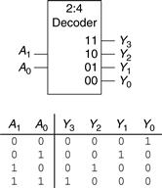
Homework
Exercise 4-13: Build and test a 2 to 4 Decoder Module in HDL
HDL Example 4.35 (pg 219) shows a way to easily create a N:2^N decoder

Slide 22
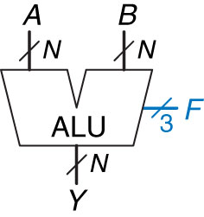
ALU – Block Diagram
ALU: Arithmetic Logic Unit
Combine Math and Logic
Heart of most computers
Has 7 functions
Control Signals
F₂ | F₁ | F₀ | Y
0 | 0 | 0 | A and B
0 | 0 | 1 | A or B
0 | 1 | 0 | A + B
0 | 1 | 1 | Not Used
1 | 0 | 0 | A and B’
1 | 0 | 1 | A or B’
1 | 1 | 0 | A – B
1 | 1 | 1 | set <

Slide 23

ALU – Block Diagram
Build an ALU with logic Functions:
What do we need?
Adder
Inverter
And
Or
Mux
Comparator
Control Signals
F₂ | F₁ | F₀ | Y
0 | 0 | 0 | A and B
0 | 0 | 1 | A or B
0 | 1 | 0 | A + B
0 | 1 | 1 | Not Used
1 | 0 | 0 | A and B’
1 | 0 | 1 | A or B’
1 | 1 | 0 | A – B
1 | 1 | 1 | set <
How would we design this? Let’s draw it out …

Slide 24
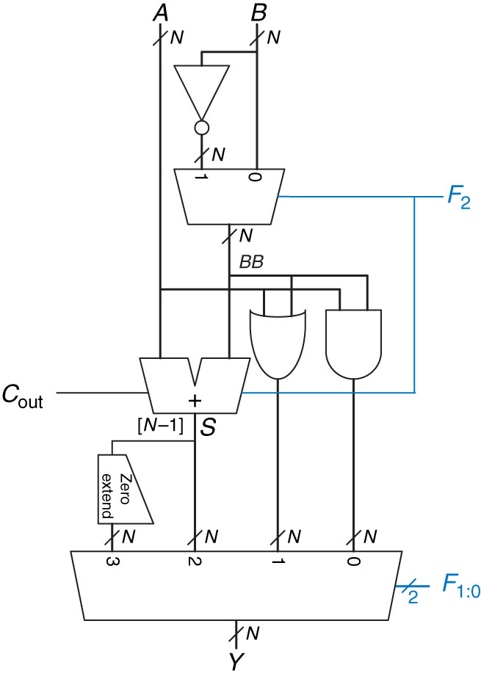
ALU
Figure 5.15 N-bit ALU

Slide 25

25

